Slide 1
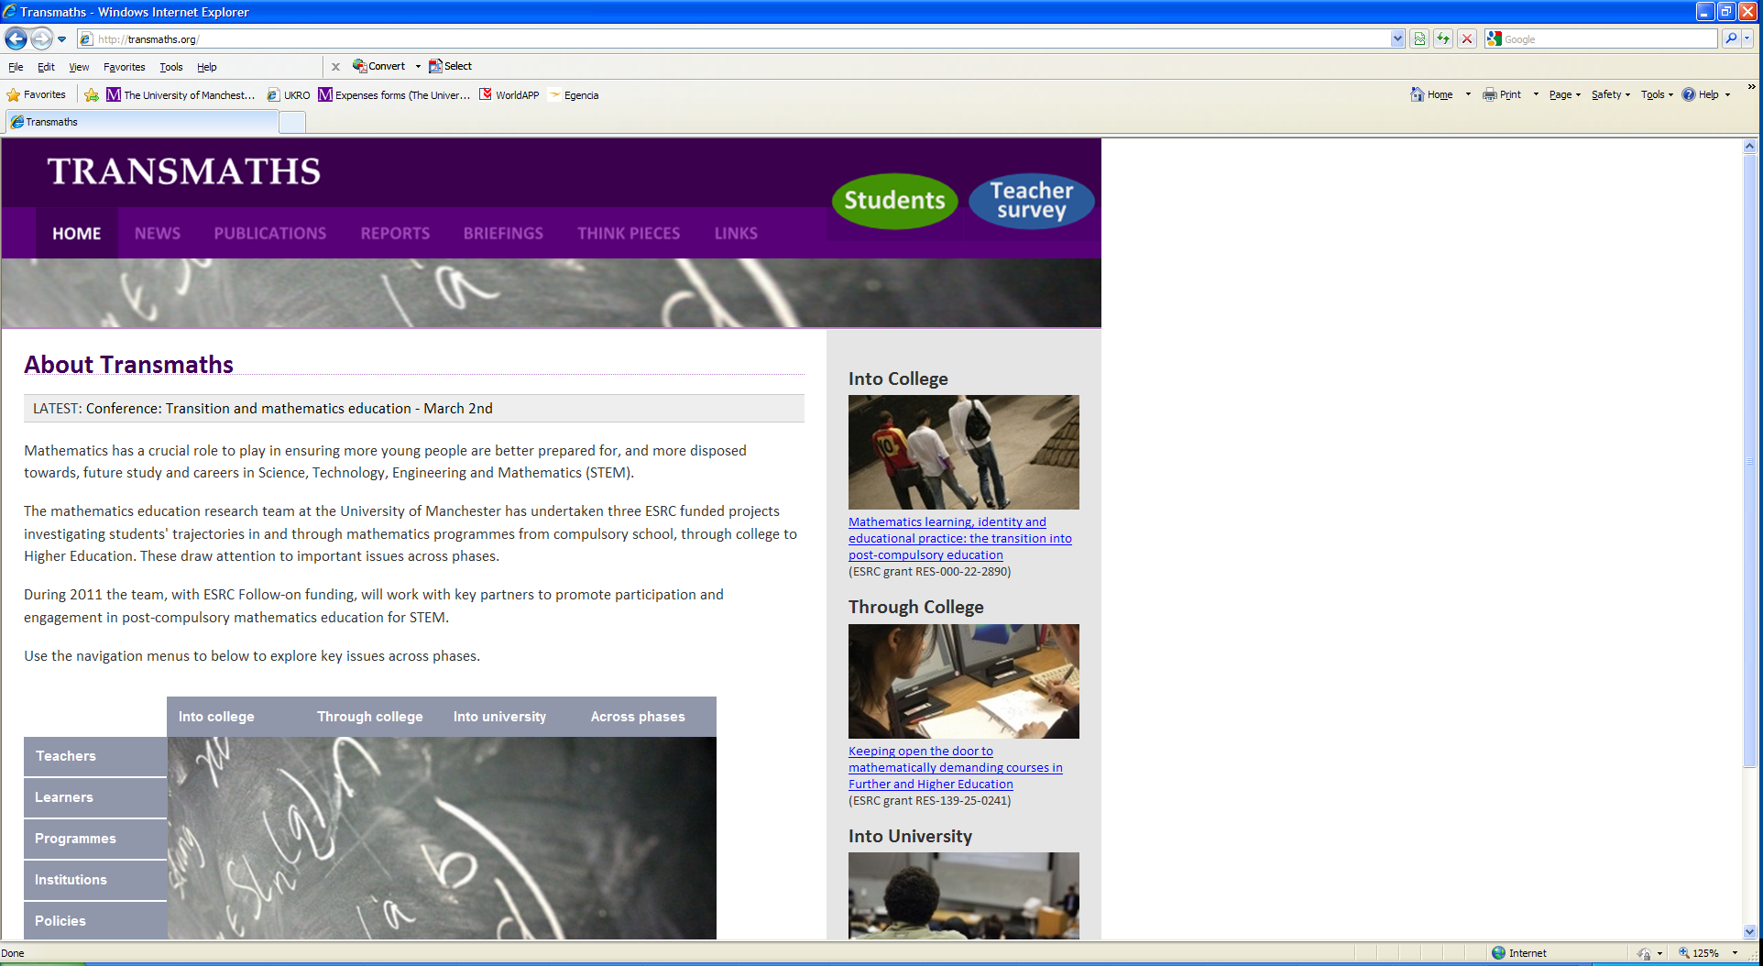



Building on Transmaths: TeLePriSM
Teaching and Learning Practices
in Secondary Mathematics
Maria Pampaka
2nd March 2012
Formal ESRC Title:
“Mathematics teaching and learning in secondary schools: the impact of pedagogical practices on important learning outcomes” (RES-061-25-0538)

Slide 2
Outline
Overall aim: to show how we built on TransMaths to develop Teleprism
Aims and design
Analytical Framework
Instrumentation
Teleprism: some preliminary findings from the first data point

Slide 3
The TransMaths projects:
Design and Aims
TLRP Aim: To understand how cultures of learning and teaching can support learners in ways that help them widen and extend participation in mathematically demanding courses in Further and Higher Education (F&HE)
AS Mathematics Vs AS Use of Mathematics
TransMaths: To understand how 6th Form and Further Education (pre-university) students can acquire a mathematical disposition and identity that supports their engagement with mathematics in 6fFE and in Higher Education (HE)
Focus on Mathematically demanding courses in HE
Teleprism
Teachers’
Survey

Slide 4
Teleprism: Design and Aims
Aim: To map secondary students’ learning outcomes and choices, including dispositions and attitudes, together with the teaching they are exposed to.
Surveys for students from Years 7 to 11 (3 times) and also for their mathematics teacher (twice).
Case studies in a small number of schools with lesson observations and interviews with students and teachers.

Slide 5
Teleprism: Detailed Aims
(i) to understand how learners’ dispositions to study Mathematics develop through Secondary School (i.e. KS3 and KS4)
to understand how mathematics pedagogies vary across different situations and contexts,
to understand how different pedagogies, programmes and school contexts influence learning outcomes, including dispositions, and
to solve a series of measurement and analytical challenges involving a synthesis of longitudinal and cross-sectional analyses, and dealing with missing data.

Slide 6
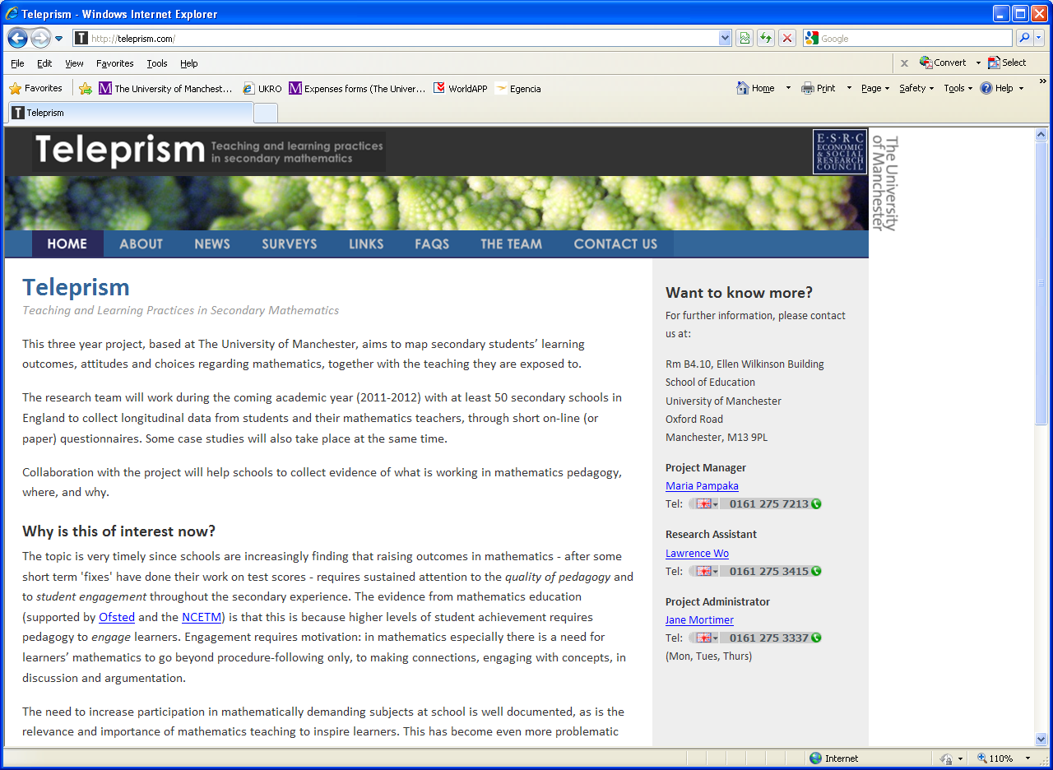
A common analytical framework
Figure 1: Analytical Framework
TeLePriSM

Slide 7
Teachers’
Survey

Slide 8
What have we measured? DISPOSITIONS
What are we measuring?
Disposition to go into HE
Disposition to complete HE course
Disposition to study more mathematics (Maths disposition)
Teleprism:
A measure of dispositions / attitudes
We also have questions about disposition to go into HE (possibly)

Slide 9
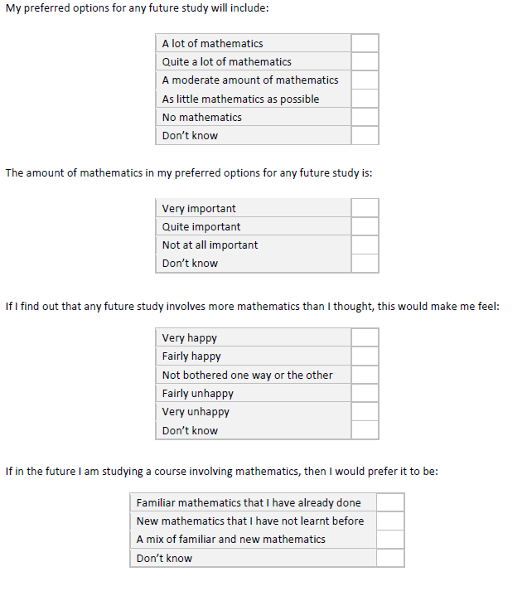
Maths Dispositions / Attitudes…
TransMaths instruments (left) were considered
BUT…
complicated for younger students
PLUS more instruments on literature on attitudes, affect ➔

Slide 10
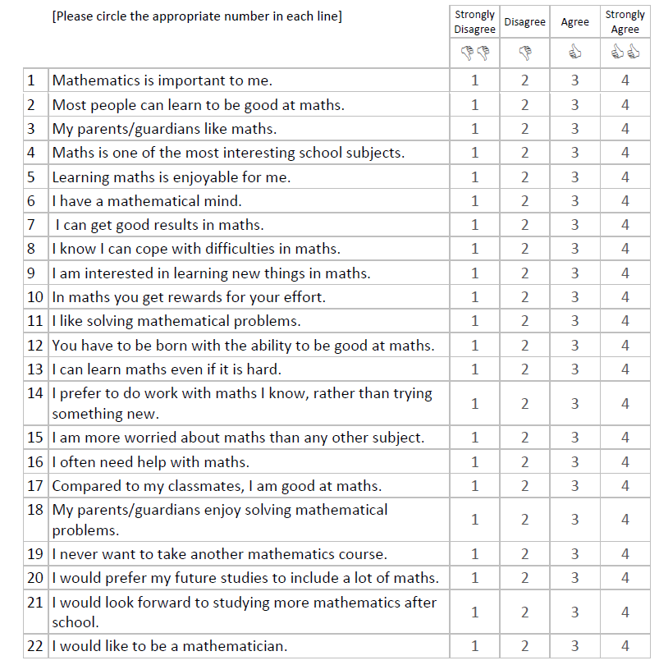
How much do you agree or disagree with the following statements?
Measurement question:
Can we get a ‘unified’ measure of disposition/attitude towards maths out of this?
Preliminary findings: promising

Slide 11
What have we measured? Mathematics Self Efficacy
What are we measuring?
MSE Instrument of 30 items:
3 difficulty levels
7 mathematical competences
Pure and Applied/Modelling
MSE Instrument of 10 items of different mathematical areas
Confidence in the same 10 mathematical areas
Teleprism:
A measure of mathematics self efficacy
Some common items with TLRP

Slide 12
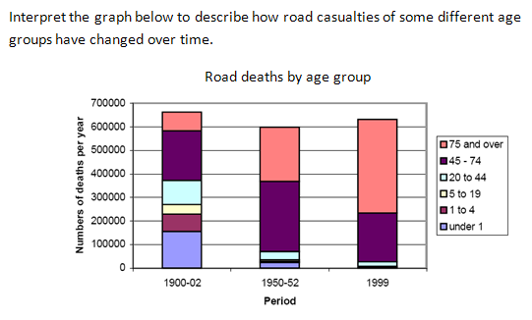
Measuring Maths Self Efficacy
Contextualised items…TLRP (applicable for Year 11, 10,…)
Example: How confident are you to interpret complex or unfamiliar graphs and charts such as:

Slide 13
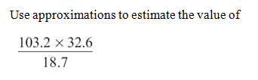

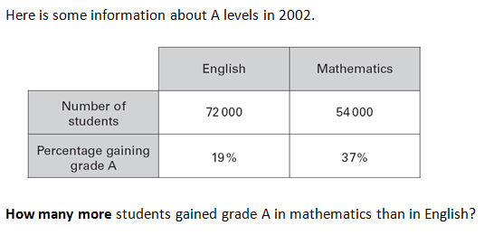
More items for younger students…
From…Previous exam papers (2006 to 2009)
  AQA
  Edexcel
  GCSE
  GCSE F
  MALT
  OCR
  SATS

Slide 14
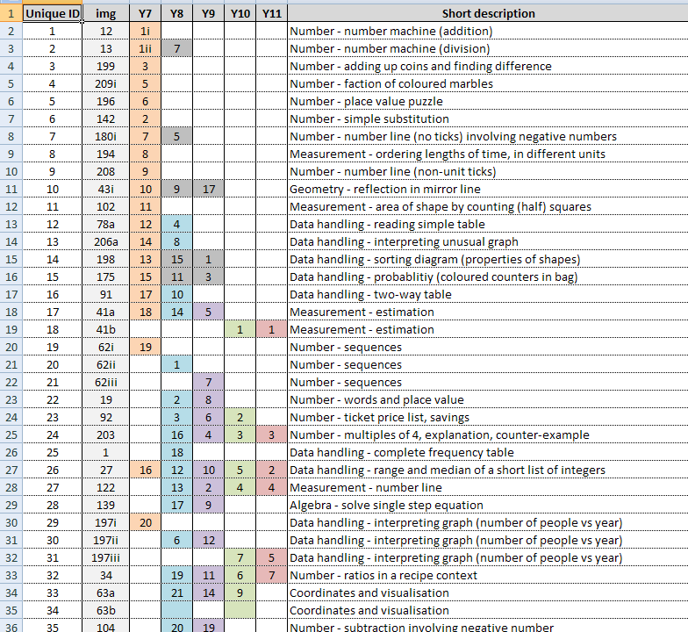
Bank of 217 items
Piloted 35 items (only Years 7 to 10)
Used 56 items for main study

Slide 15
What have we measured? “Teaching Mathematics
What are we measuring?
Teachers’
Survey
Students’ perception of pre-university pedagogy
Students’ perception of university pedagogy
Teleprism:
Measures of teachers’ self report teaching
Students’ perception of teaching
Common items between the two as well as between TransMaths

Slide 16
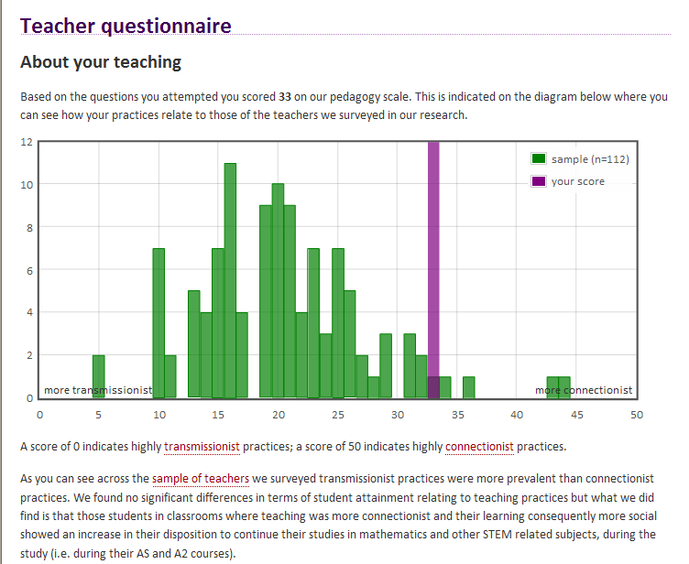
www.transmaths.org

Slide 17
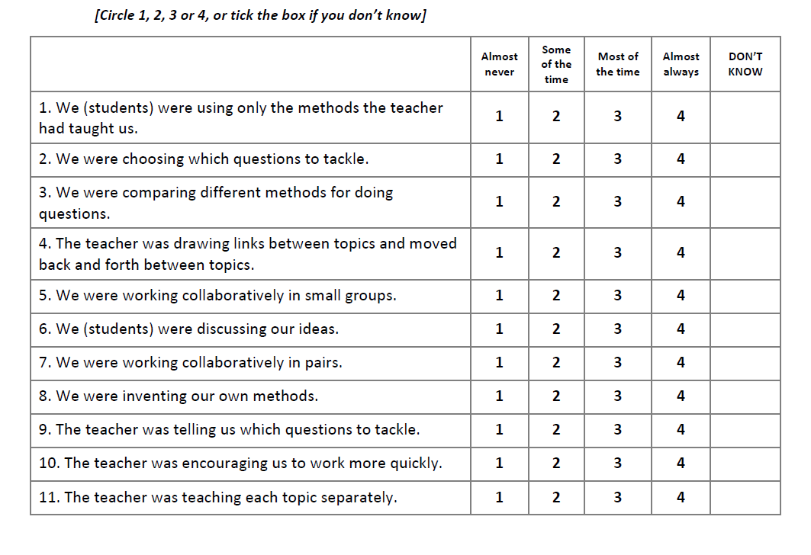
TLRP teacher survey➔ TransMaths Students’ Survey
Teleprism: We tried to keep these common

Slide 18
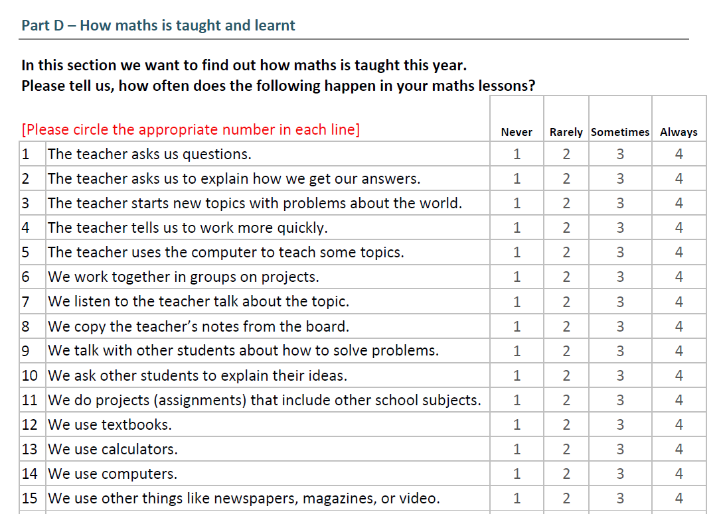

Slide 19
The survey design…Data Point 1 (DP1)

Slide 20
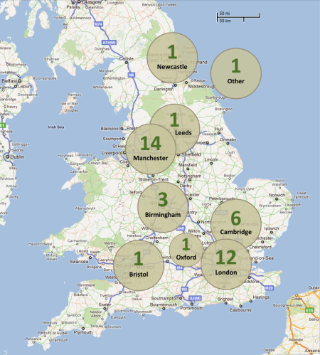
DP1 – Participating schools and students

Slide 21


DP1 – Some preliminary findings
Top 10 favourite and least favourite topics

Slide 22
Students’ attitudes to mathematics

Slide 23
Students’ report of teaching practices

Slide 24
Our current ‘impact’ dilemma:
Reporting back to schools DP1:
To who? What? How?
Thank you!
Q&A
www.teleprism.com

